Slide 1

2015 Flight Delays and Cancellation
Insights into Flight Delays, Cancellations, and Operational Efficiency

Slide 2

Team Members
Introduction: "Our success in this project was driven by the collaborative efforts of our dedicated team.“
Mohammed Sameh
Role: Data Cleaner
Ahmed Alaa
Role: Insights and Dashboard Creator
Omar Yasser
Role: Insights and Dashboard Creator
Mahmoud Raslan
Role: Report and Presentation Creator

Slide 3

Introduction to the Flight Data
The dataset consists of three CSV files: airlines.csv, airports.csv, and flights.csv.
Flights.csv is the primary data file with the following columns:
Date Information: YEAR, MONTH, DAY, DAY_OF_WEEK.
Flight Identifiers: AIRLINE, FLIGHT_NUMBER, TAIL_NUMBER.
Flight Location: ORIGIN_AIRPORT, DESTINATION_AIRPORT.
Time Details: SCHEDULED_DEPARTURE, DEPARTURE_TIME, SCHEDULED_ARRIVAL, ARRIVAL_TIME.
Delays and Cancellations: DEPARTURE_DELAY, ARRIVAL_DELAY, TOTAL_DELAY, CANCELLED, CANCELLATION_REASON.
Flight Operations: TAXI_OUT, WHEELS_OFF, ELAPSED_TIME, AIR_TIME, DISTANCE, WHEELS_ON, TAXI_IN.
Flight Outcomes: DIVERTED, IS_DELAYED.

Slide 4

Initial Data Observations
Data Volume: Millions of records representing flights over a specified period.
Common Issues Detected:
Missing Data: Observed in columns like DEPARTURE_TIME, ARRIVAL_TIME, DEPARTURE_DELAY, and ARRIVAL_DELAY.
Outliers: Extreme delay values or inconsistencies in DEPARTURE_DELAY and ARRIVAL_DELAY.
Irregularities: Flights with missing or incorrect cancellation reasons or unexpected values in CANCELLED and DIVERTED fields.
Data Type Mismatches: Certain columns may have incorrect data types (e.g., times stored as text).

Slide 5

Data Cleaning Process
Outlier Removal:
Checked for outliers in LATITUDE and LONGITUDE using the IQR method.
Removed any values outside 3 times the IQR from the 1st and 3rd quartiles.
Handling Missing Values:
Dropped any rows with missing values using dropna().
Dropped Unnecessary Columns:
Removed delay-related columns that were not needed for analysis:
AIR_SYSTEM_DELAY, SECURITY_DELAY, AIRLINE_DELAY, LATE_AIRCRAFT_DELAY, WEATHER_DELAY.

Slide 6
Data Cleaning Process
Cancellation Data Fixes:
Filled missing values in the CANCELLATION_REASON column with "No Cancellation".
Mapped existing values to more meaningful labels:
A → Airline/Carrier
B → Weather
C → National Air System
D → Security
Date/Time Format Conversion:
Converted flight times (e.g., SCHEDULED_DEPARTURE, DEPARTURE_TIME, etc.) to a proper time format using pd.to_datetime().

Slide 7

Post-Cleaning Summary
Creation of New Features:
Created a new TOTAL_DELAY column by summing DEPARTURE_DELAY and ARRIVAL_DELAY.
Added a new IS_DELAYED column, marking flights as Delayed if the total delay was greater than 15 minutes.
Improved Data Quality:
After cleaning, the dataset has no missing values, irrelevant columns, duplicates, or extreme outliers, making it suitable for analysis.

Slide 8
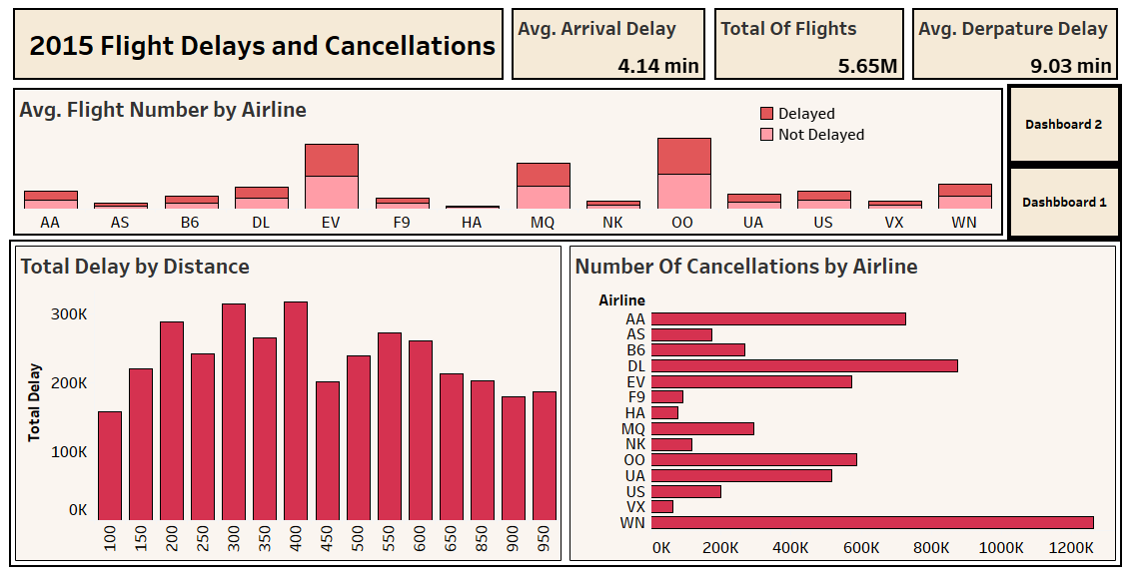
Dashboard 1 Overview
Title: Airline Operations and Delays
Average Flight Number by Airline: Shows airline activity levels.
Total Delay by Distance: Highlights delay variations based on flight distance.
Cancellations by Airline: Identifies airlines with higher cancellation rates.
Insight: This dashboard focuses on airline performance, delays, and cancellations.

Slide 9

Key Flight Metrics
Total Flights: 5,019,847
Represents the total number of recorded flights, offering a broad overview of air traffic activity.
Number of Airlines: 14
Includes data from 14 airlines, enabling comparisons of flight volume and performance across carriers.
Average Departure Delay: 0.94 minutes
Indicates efficient operations, with minimal delays in flight departures.
Average Arrival Delay: -5.04 minutes
Shows that, on average, flights arrive slightly ahead of schedule, highlighting effective in-flight time management.

Slide 10
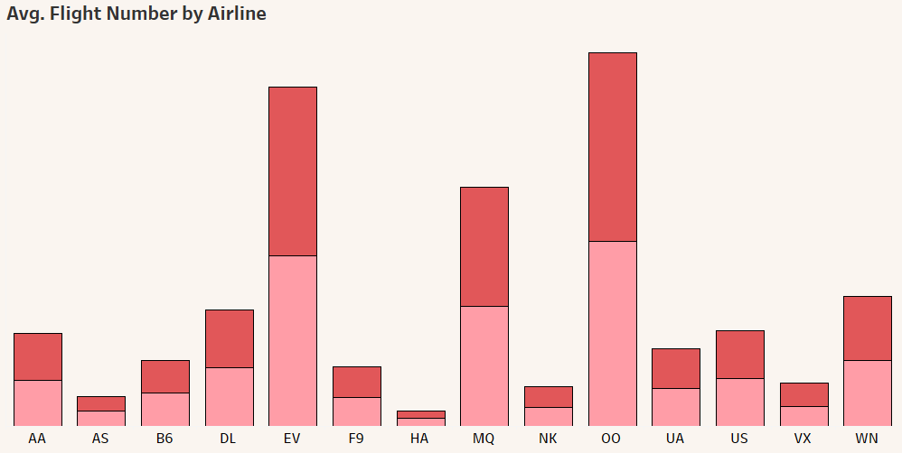

Average Flight Number by Airline
Chart Description
This stacked column chart displays the average number of flights for each airline.
Each airline’s average flight count is visualized, showing the distribution of flight operations.
Key Insight
Airlines with the highest average number of flights indicate greater operational activity, suggesting they may have a larger market share or more frequent flight schedules.
This insight helps understand the operational scale and market presence of each airline.

Slide 11
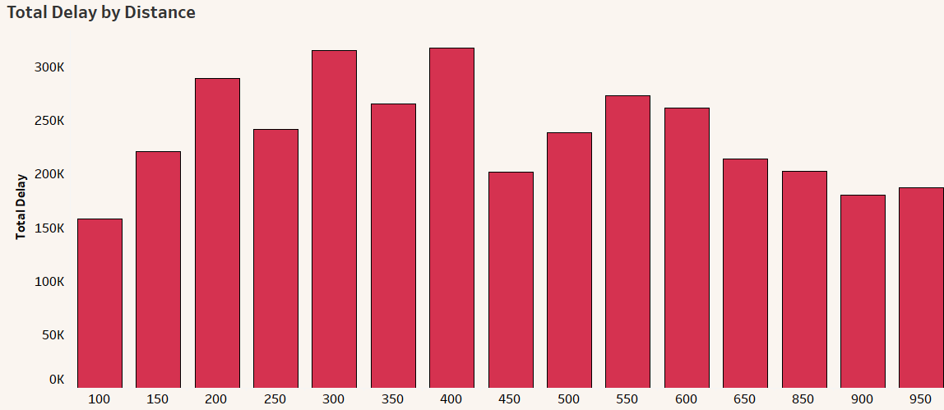



Total Delay by Distance
Chart Description
This column chart displays the total delay (departure and arrival) based on the distance of flights.
It shows how flight delays vary depending on the length of the journey.
Key Insight
The chart helps identify whether longer flights experience more delays compared to shorter ones, providing insight into whether distance contributes to delay patterns. This can guide operational improvements for certain flight lengths.

Slide 12
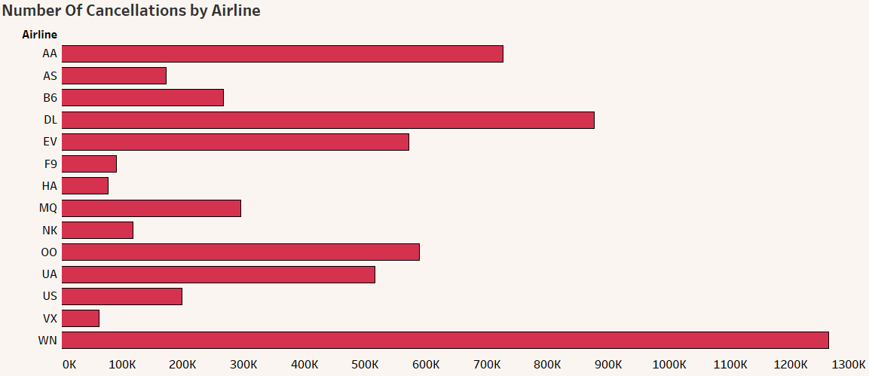
Cancellations by Airlines
Chart Description
This bar chart shows the total number of flight cancellations for each airline..
It highlights which airlines experience more frequent cancellations.
Key Insight
The chart helps identify airlines that may have operational challenges leading to cancellations. Analyzing this can help focus efforts on improving reliability and reducing disruptions for certain airlines.

Slide 13
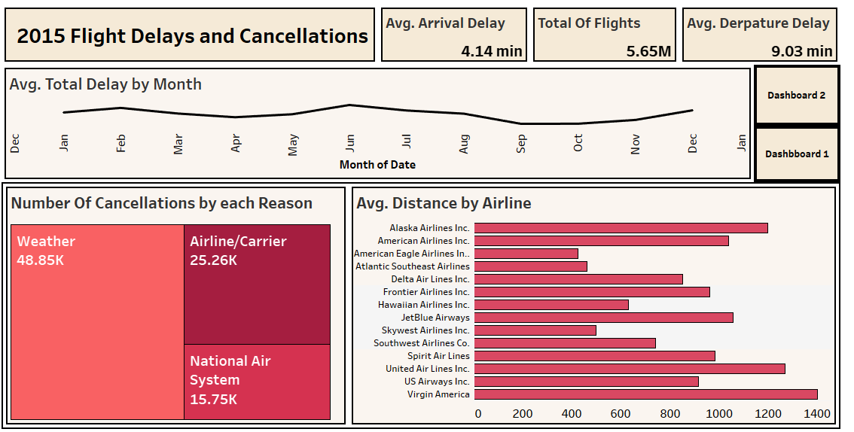
Dashboard 2 Overview
Title: Delay and Cancellation Analysis
Average Total Delay by Month: Tracks monthly delay trends.
Cancellations by Reason: Breaks down causes of cancellations.
Average Distance by Airline: Compares airlines based on flight distance.
Insight: This dashboard examines delay trends and reasons for cancellations.

Slide 14
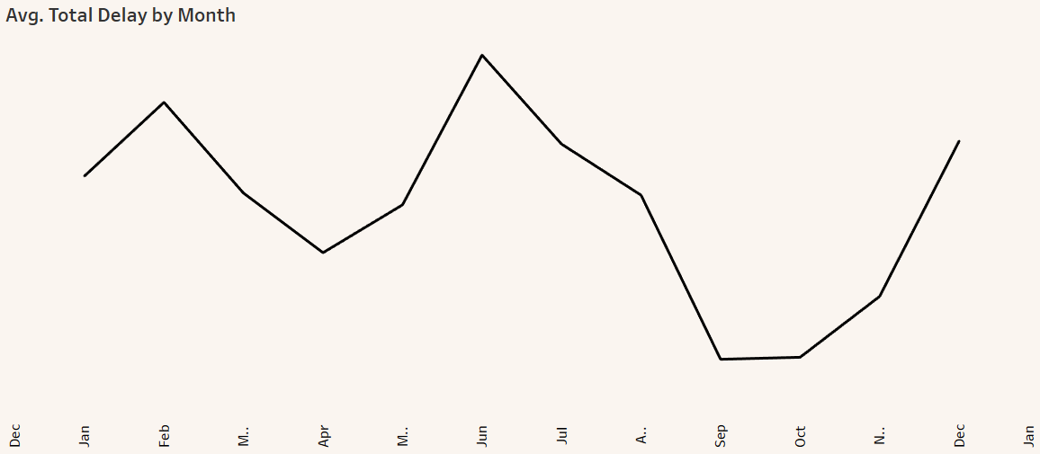

Average Total Delay by Month
Chart Description
This line chart shows the average total delay (both departure and arrival delays) for each month.
It helps identify monthly patterns in flight delays, highlighting periods where delays tend to increase or decrease.
Key Insight
The chart reveals any seasonal trends in delays, such as potential increases during busy travel months (e.g., summer or holiday periods), helping to pinpoint times when airlines may need to enhance operational efficiency.

Slide 15
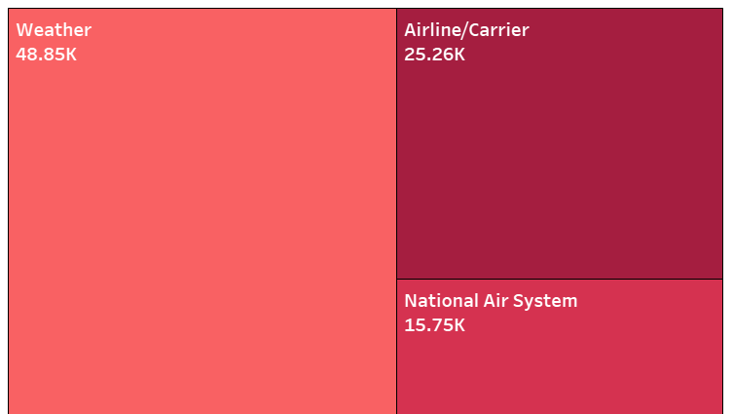
Cancellation Reasons Breakdown
Chart Description
This tree chart visualizes the distribution of cancellation reasons across all flights.
It shows the proportion of flights canceled due to different reasons such as weather, technical issues, or other factors.
Key Insight
The chart highlights the most common causes of flight cancellations, which can inform strategies to mitigate delays and improve reliability. Understanding these reasons helps airlines focus on areas needing operational improvements.

Slide 16
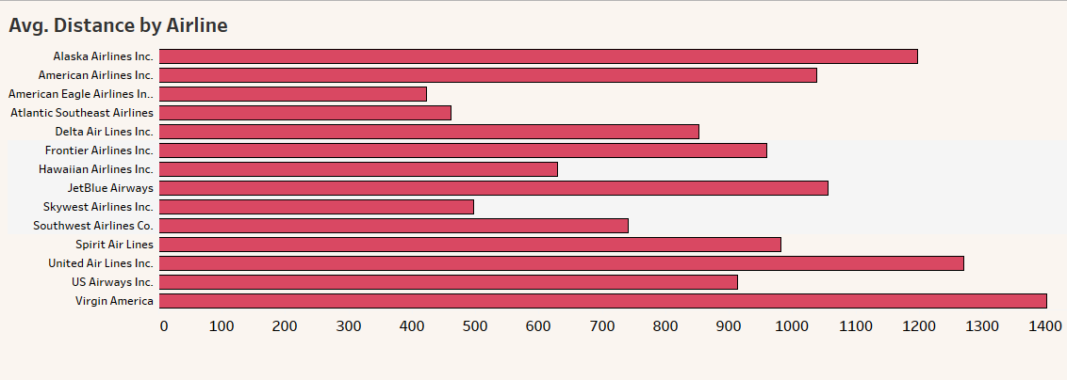

Average Distance by Airline
Chart Description
This bar chart compares airlines based on the average distance traveled per flight.
It highlights which airlines operate longer or shorter routes on average .
Key Insight
The chart helps to identify airlines that specialize in long-haul flights versus those focusing on shorter domestic routes. This can indicate the geographic reach or market focus of different carriers.

Slide 17

Conclusion
In summary, our analysis of the flight dataset has provided valuable insights into airline performance and operational efficiency. Key findings include:
A total of over 5 million flights, highlighting significant air traffic activity.
The distribution of airlines, revealing those most active in the market.
Insights into average delays, indicating overall efficiency in departures and arrivals.
An understanding of cancellation reasons, which can guide improvements in operational strategies.

Slide 18

Thank You

